Slide 1
MSiA
Research Computing Services
Unix Command Line
https://github.com/nuitrcs/commandlineworkshop
Janna Nugent: janna.nugent@northwestern.edu
Alper Kinaci: akinaci@northwestern.edu
Christina Maimone: christina.maimone@northwestern.edu

Slide 2
Unix Command Line
With Bonus vi!

Slide 3

Designed for ease of use:

Slide 4
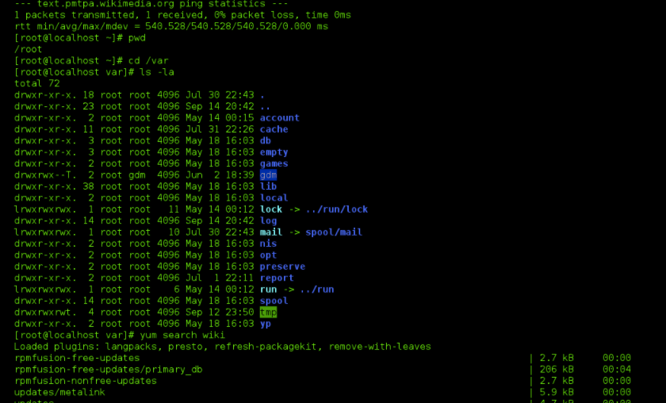

Designed for power
NOT
Designed for ease of use:

Slide 5
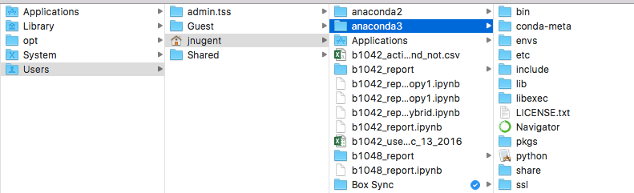
Finder on a Mac

Slide 6
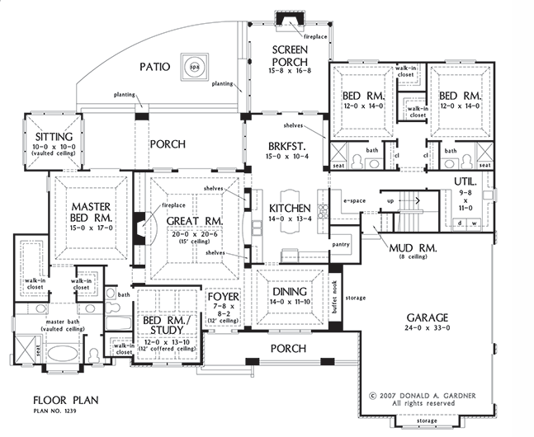
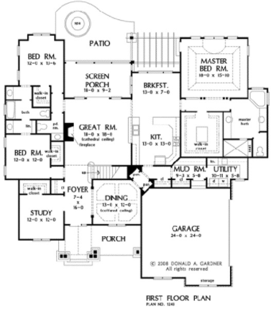
Finder on a Mac

Slide 7
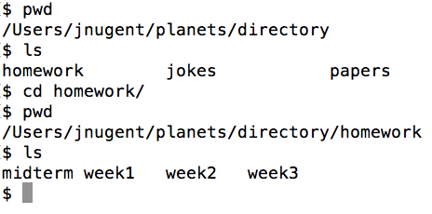
looking around at files in Unix

Slide 8

Unix Command Line
/Users/jnugent/pipelines/RNAseq

Slide 9

Unix Command Line
/Users/jnugent/pipelines

Slide 10
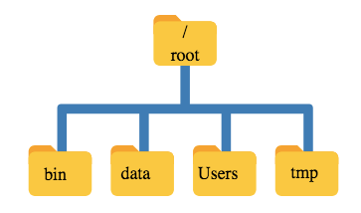

Slide 11


“Root”
a location: the base of the filesystem tree
/
a user: the superuser

Slide 12
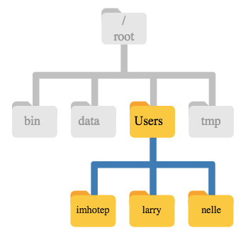

Slide 13
Finder on a Mac

Slide 14

Getting Started
Launch Microsoft Remote Desktop
click on “SSH to app1”
type “mkdir data”, hit return
type “cd data”, hit return
type “wget https://swcarpentry.github.io/shell-novice/data/shell-novice-data.zip”, hit return
type “unzip shell-novice-data.zip”, hit return

Slide 15
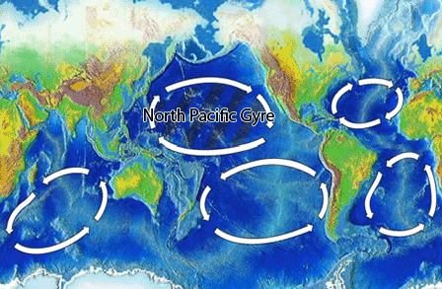
North Pacific Gyre
Great Pacific Garbage Patch

Slide 16
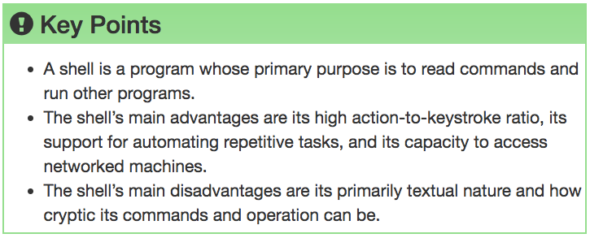

Slide 17

Navigating Files & Directories

Slide 18
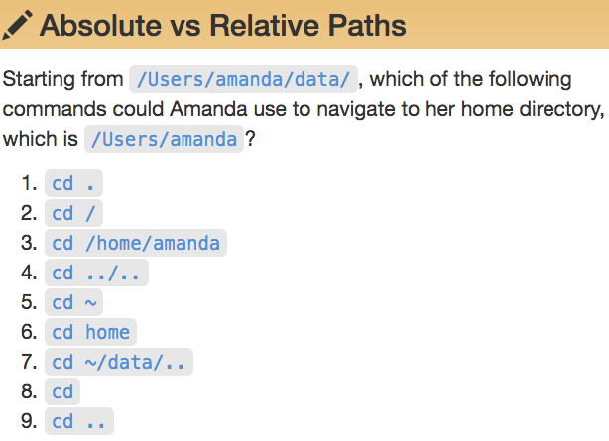
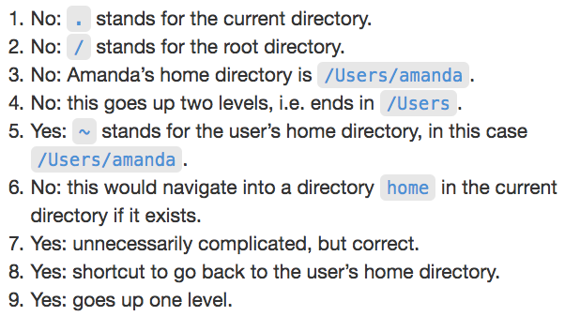


Slide 19
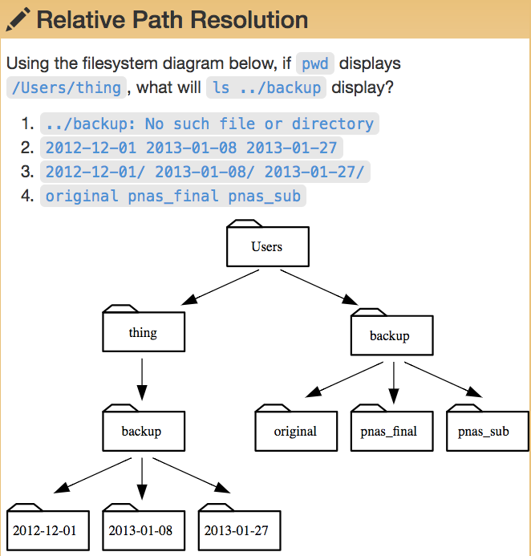

Slide 20
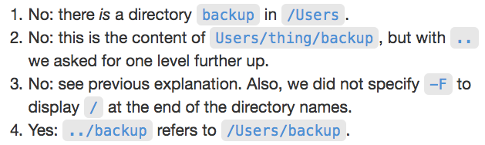
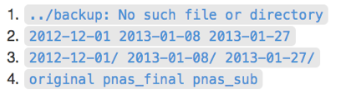

Slide 21
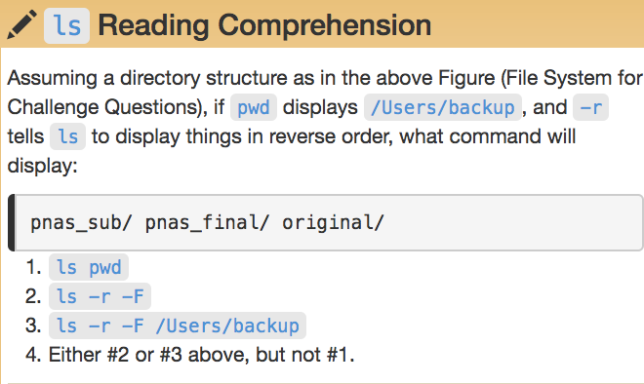
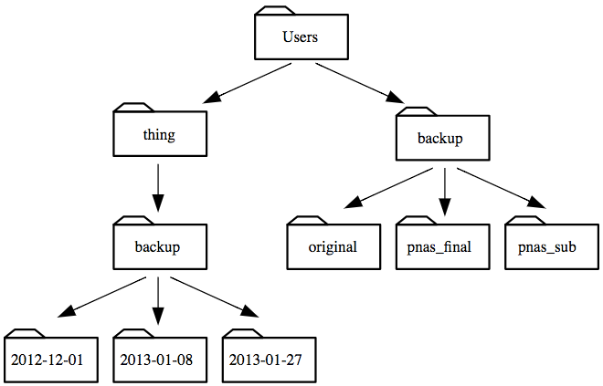

Slide 23
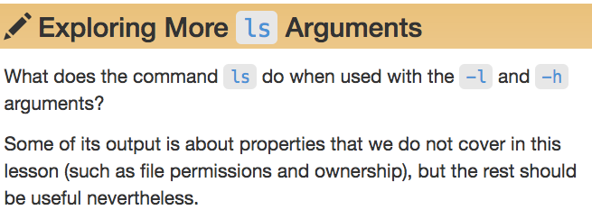
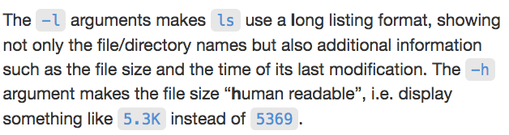

Slide 24
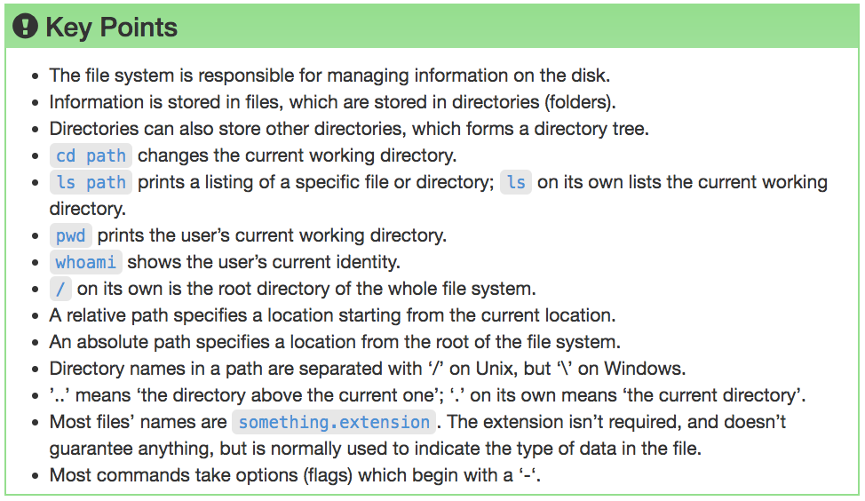

Slide 25
Working With Files & Directories

Slide 26
Good Names for Files & Directories
Don’t use whitespace (“my work”)
Don’t begin the name with a dash “-”
Don’t begin the name with a “.” unless you mean it
Use letters, numbers, “-”, “.”, “_”
If you need to use a filename with special characters,
surround the name in quotes (“- a bad name !”)

Slide 27

text editor: nano
type “nano <filename>” this will open the named file for editing or create it if it doesn’t exist
type your text: the mouse will not move the cursor - navigate with the arrow keys
save and quit: commands are on the bottom of the screen - the “^” stands for “control”

Slide 28
text editor: vi/vim
On command line: “vi test.txt”
You land in command mode
To enter insert mode: “i” where the cursor is; “o” inserts one line below that
Navigate with arrow keys
To exit insert mode: “esc”
To save: “:w”
To exit: “:q”
To exit without saving: “q!”

Slide 29
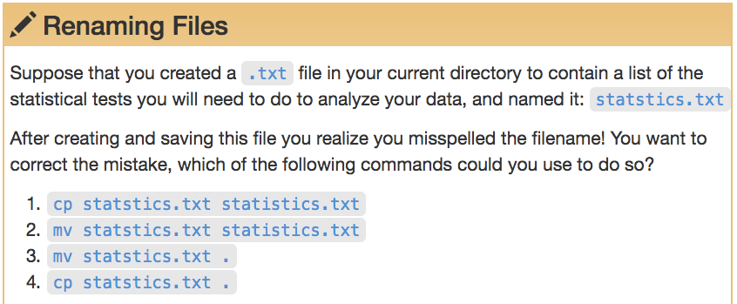
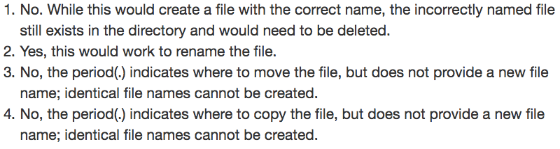

Slide 30
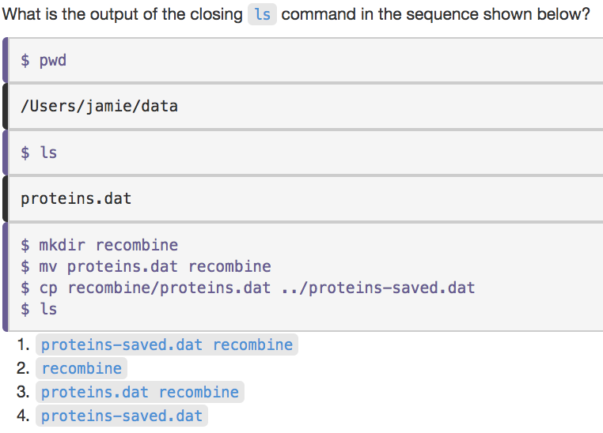

Slide 31
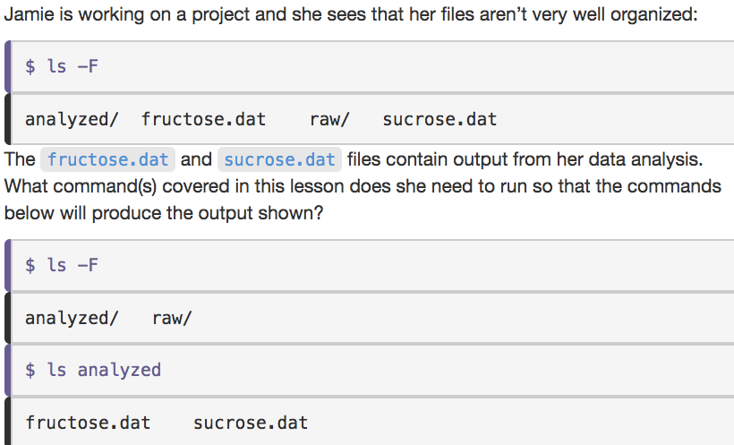

Slide 32
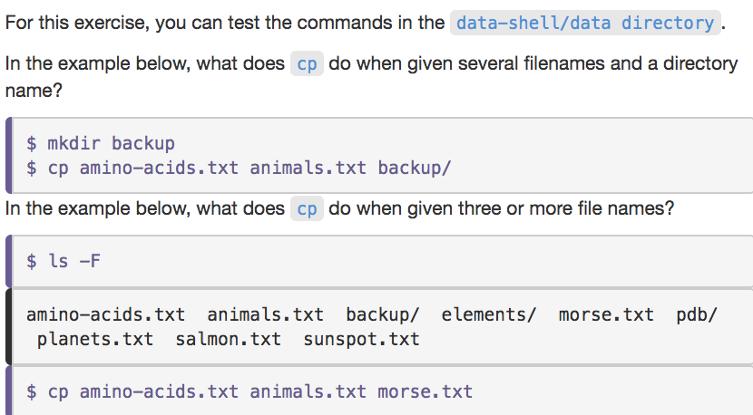
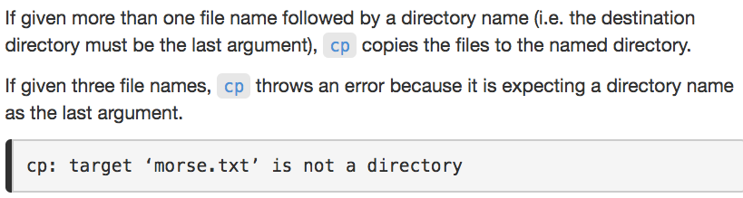

Slide 33
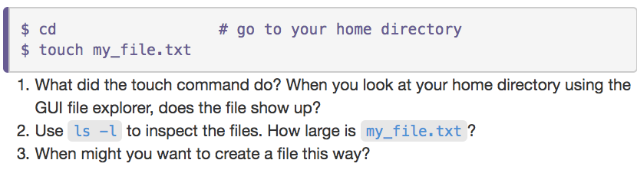

Slide 34
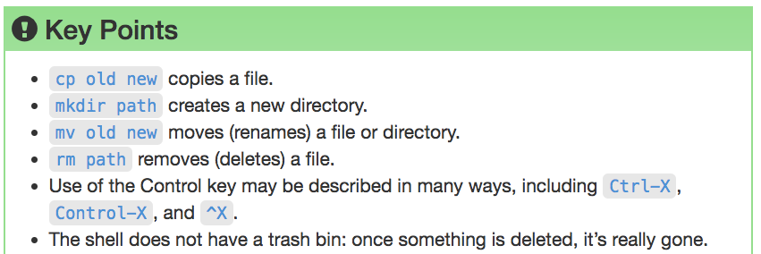

Slide 35
Pipes & Filters

Slide 36
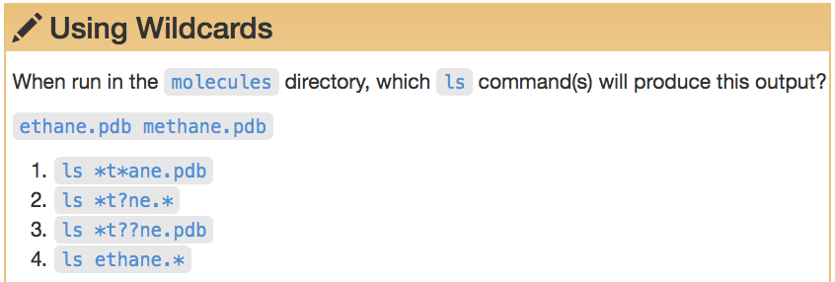
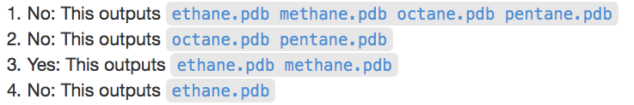

Slide 37
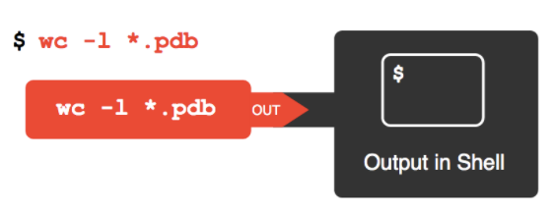

Slide 38
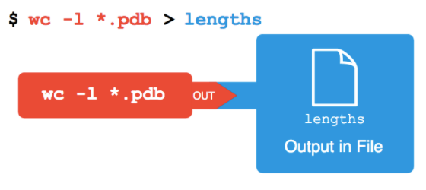

Slide 39
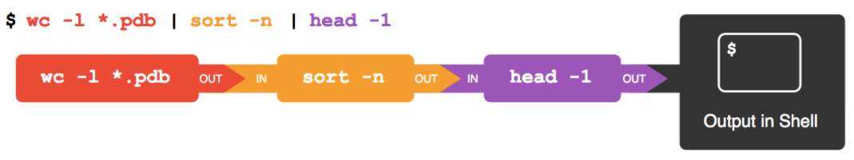

Slide 40
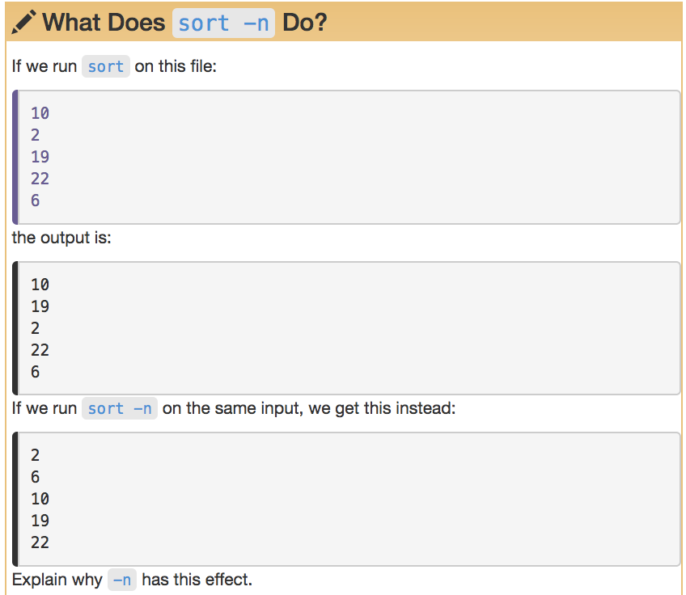

Slide 41
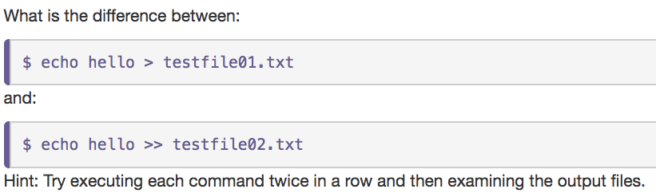

Slide 42
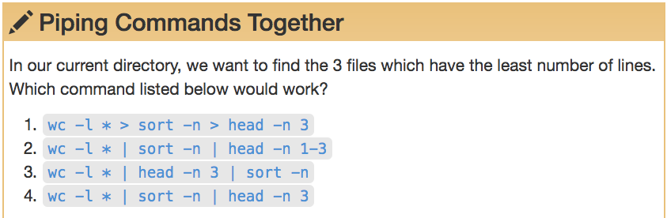
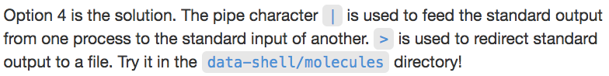

Slide 43
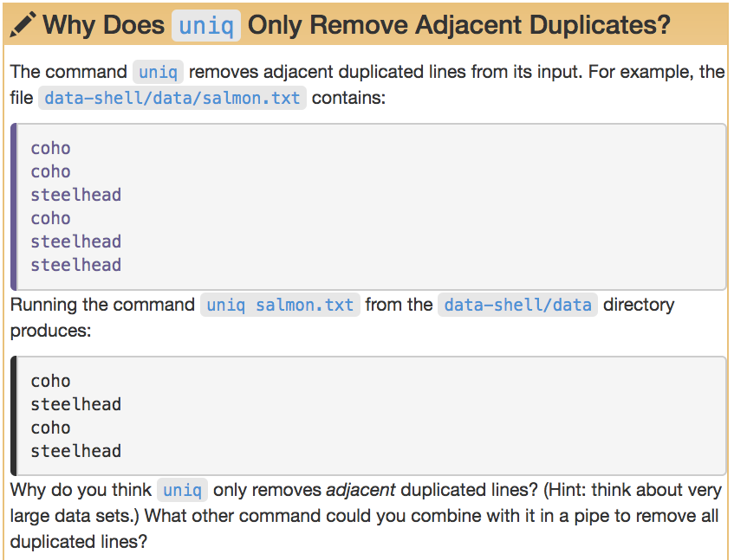

Slide 44
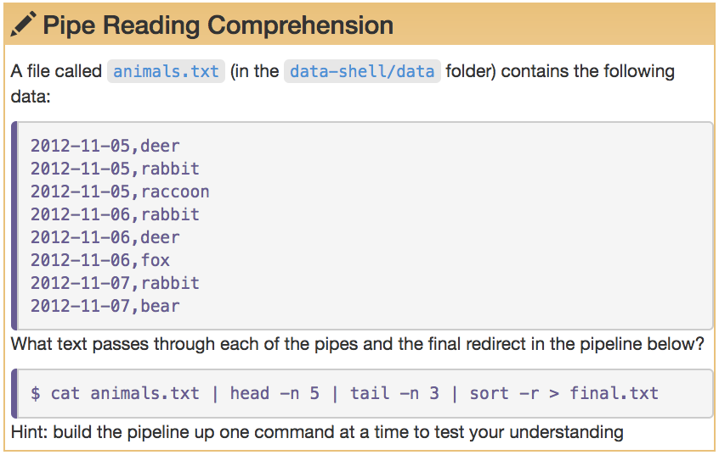

Slide 45
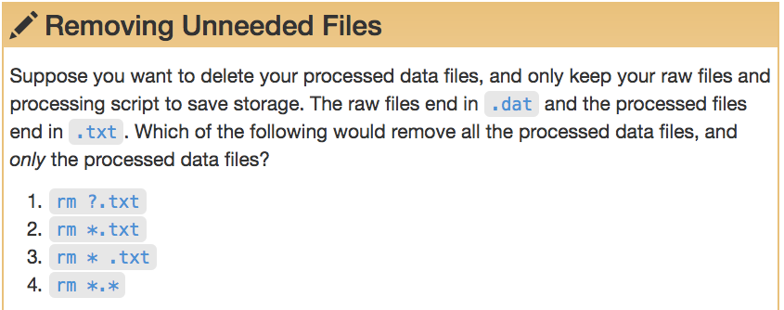

Slide 46
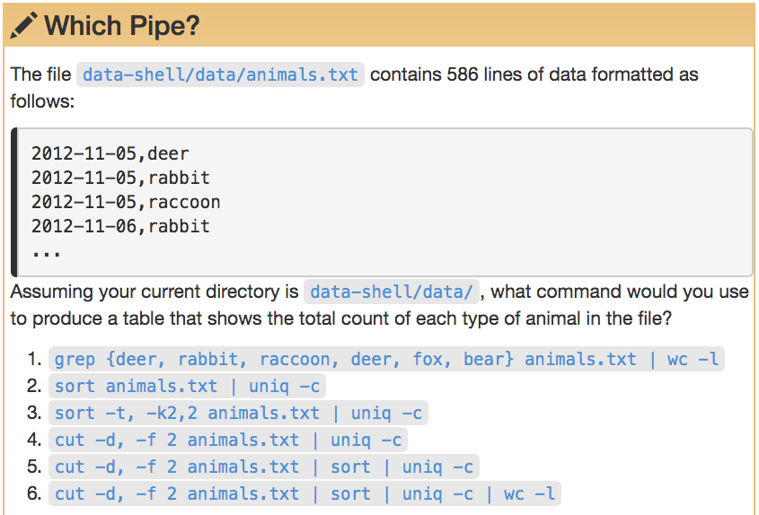

Slide 47
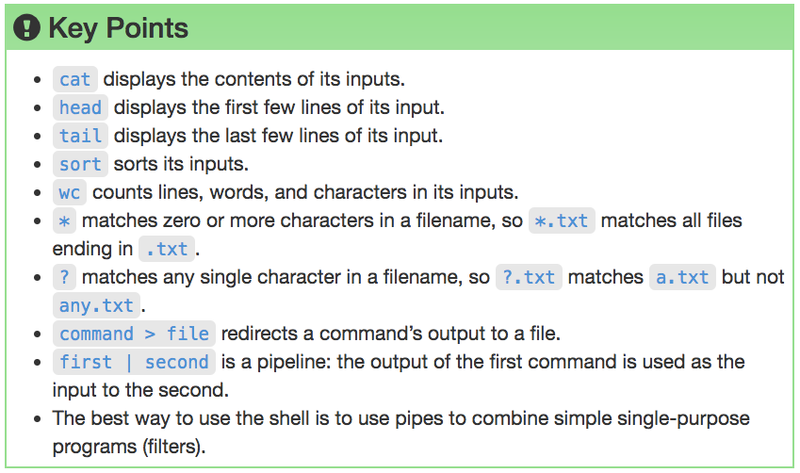

Slide 48
Loops

Slide 49
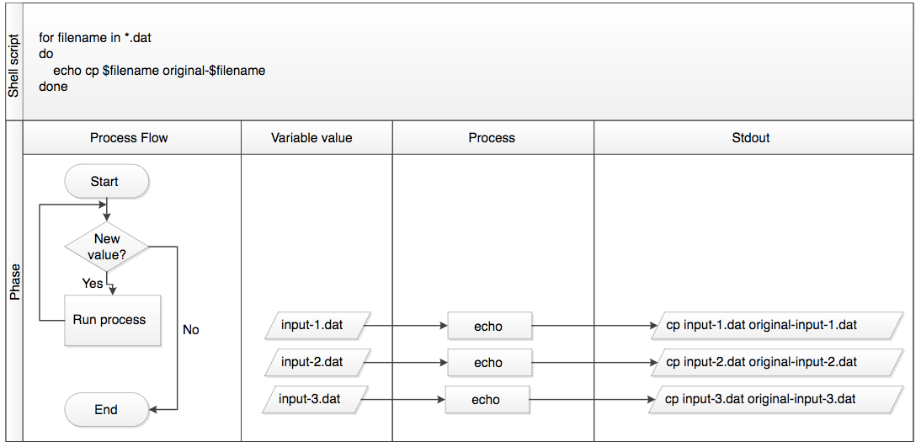
What did the loop do?

Slide 50
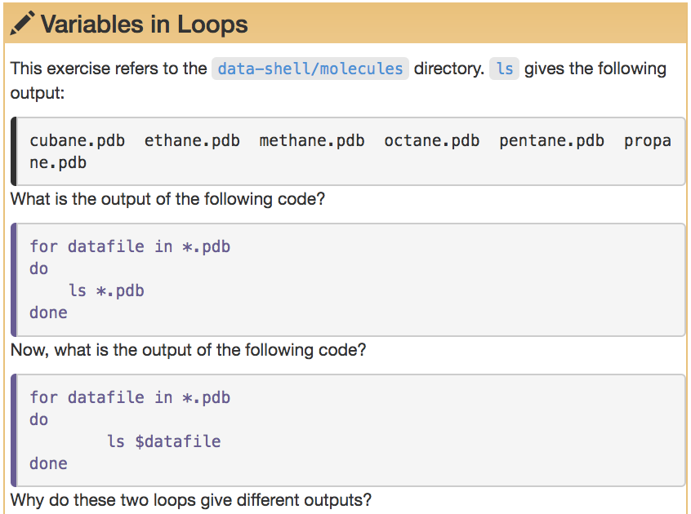

Slide 51
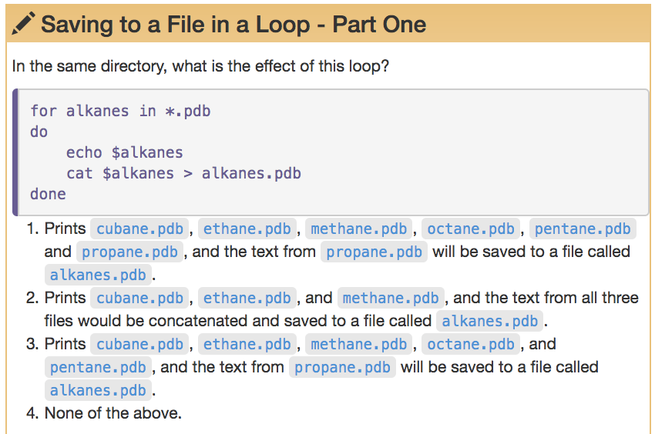

Slide 52
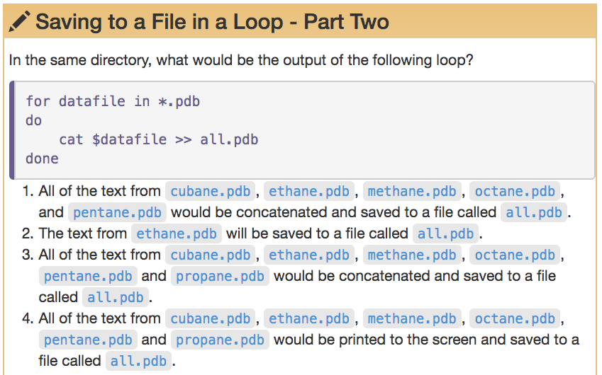

Slide 53
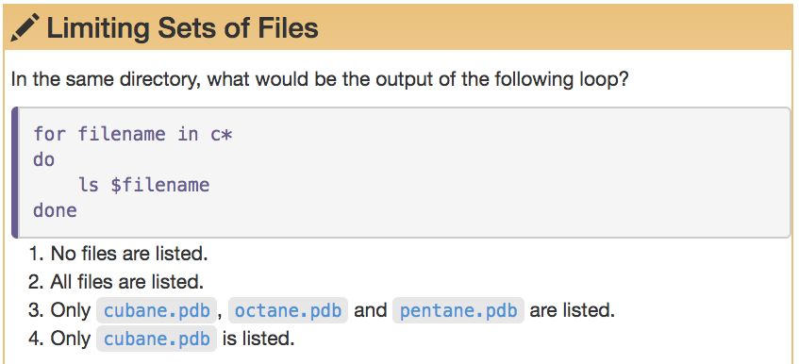

Slide 54
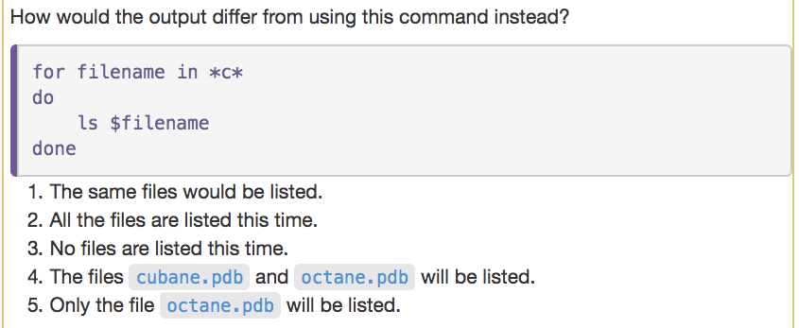

Slide 55
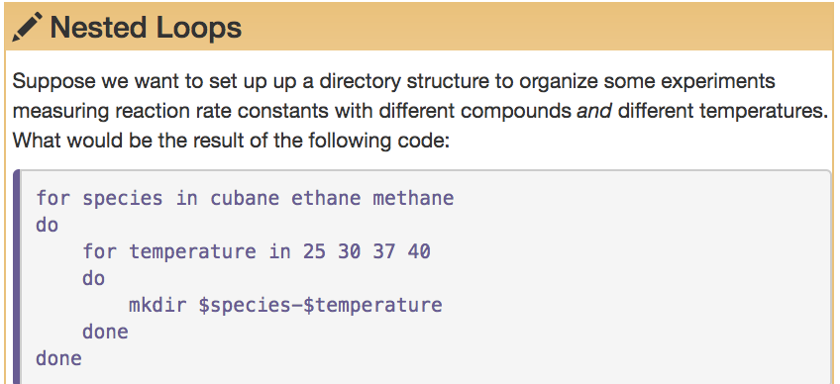
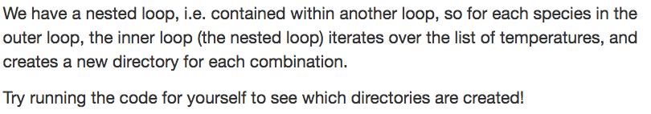

Slide 56
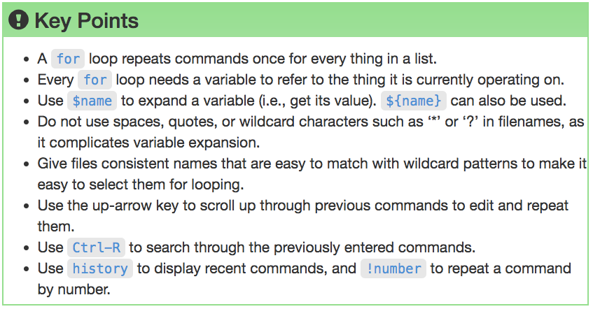

Slide 57
Shell Scripts

Slide 58


Slide 59



Slide 60


Slide 61


Slide 62
Finding Things

Slide 63


Slide 64


Slide 65


Slide 66


Slide 67
MSiA
Research Computing Services
Unix Command Line
https://github.com/nuitrcs/commandlineworkshop
Janna Nugent: janna.nugent@northwestern.edu
Alper Kinaci: akinaci@northwestern.edu
Christina Maimone: christina.maimone@northwestern.edu

